Slide 1

MANAGEMENT OF NATURAL RESOURCES
Laws and Regulation

Slide 2
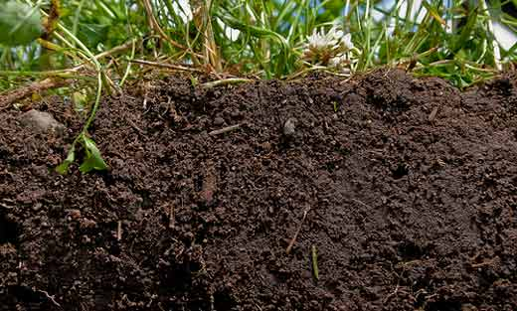
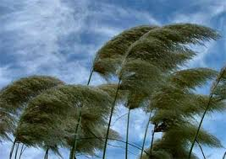
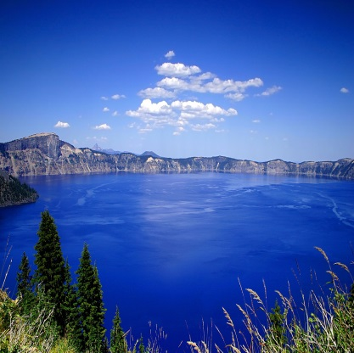
Some natural resources like soil, air and water and various components are cycled over and over again in nature.
Soil
Air
Water

Slide 3

There are international laws and regulations, and then there are our own national laws and acts for environmental protection.
There are also national and international organizations working towards protecting our environment.

Slide 4
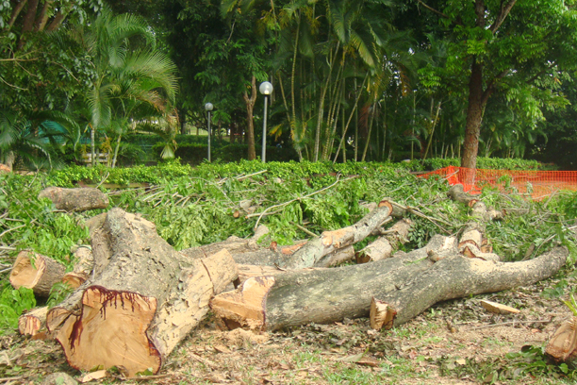

Awareness about the problems caused by unthinkingly exploiting our resources has been a fairly recent phenomenon in our society.
And once this awareness rises, some action is usually taken.

Slide 5
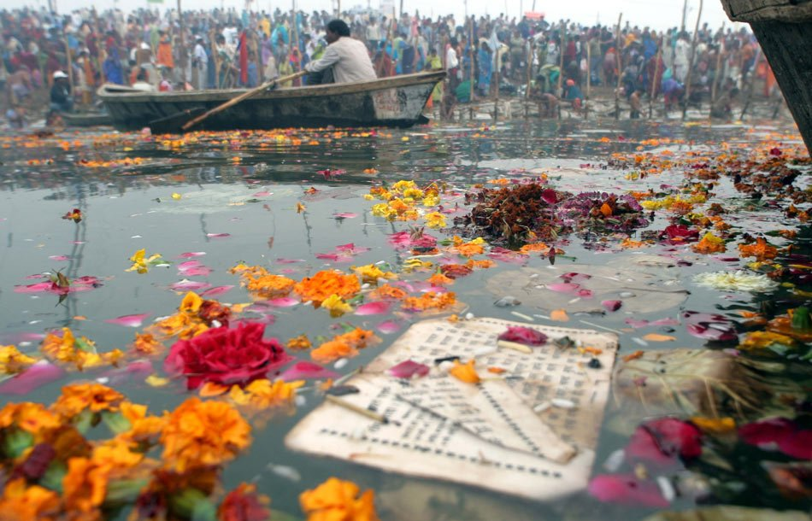
You must have heard about the Ganga Action Plan.

Slide 6
Thank You

